Slide 1



X
Performance Analytics
Business performance analysis Kimia Farma 2020-2023
Kimia Farma - Big Data Analytics
Presented by
Irziqna Auliaurrachmah

Slide 2





Irziqna Auliaurrachmah
Undergraduate Student
I'm currently a 4th-semester Statistics student at Sepuluh Nopember Institute of Technology (ITS) with a strong passion for data analysis and problem-solving. I aspire to become a data analyst and have developed skills in SQL, R, and Python to analyze data, derive insights, and support decision-making using Statistical Method. I'm eager to apply my knowledge to real-world projects, continuously improve my analytical abilities, and stay updated with industry trends
Surabaya, Jawa Timur
irziqnaulia@gmail.com
https://www.linkedin.com/in/irziqna-auliaurrachmah/

Slide 3

About Company
Kimia Farma is the first pharmaceutical industry company in Indonesia, established by the Dutch East Indies government in 1817. Initially, the company was named NV Chemicalien Handle Rathkamp & Co. In 1958, the Government of the Republic of Indonesia merged several pharmaceutical companies into PNF (Perusahaan Negara Farmasi) Bhinneka Kimia Farma.
On August 16, 1971, the legal status of PNF was changed to a Limited Liability Company, leading to the company's name change to PT Kimia Farma (Persero). Later, the company’s name was changed from PT Kimia Farma (Persero) Tbk to PT Kimia Farma Tbk, effective as of February 28, 2020, as stated in the Deed of Minutes of the Extraordinary General Meeting of Shareholders (RUPSLB) Number 18 dated September 18, 2019. Additionally, Kimia Farma became a member of the state-owned pharmaceutical holding company (Holding BUMN Farmasi).

Slide 4
Project Portfolio
As a Big Data Analytics Intern at Kimia Farma, my role involves tackling various challenges that require a deep understanding of data and strong analytical skills. One of my main projects is evaluating Kimia Farma's business performance from 2020 to 2023, with a dataset:
kf_final_transaction.csv
kf_inventory.csv
kf_kantor_cabang.csv
kf_product.csv
The output is to create an analysis table in BigQuery and develop a Performance Analytics Dashboard for Kimia Farma's Business (2020-2023) using Google Looker Studio.
Project explanation video here!
Github repository here!

Slide 5
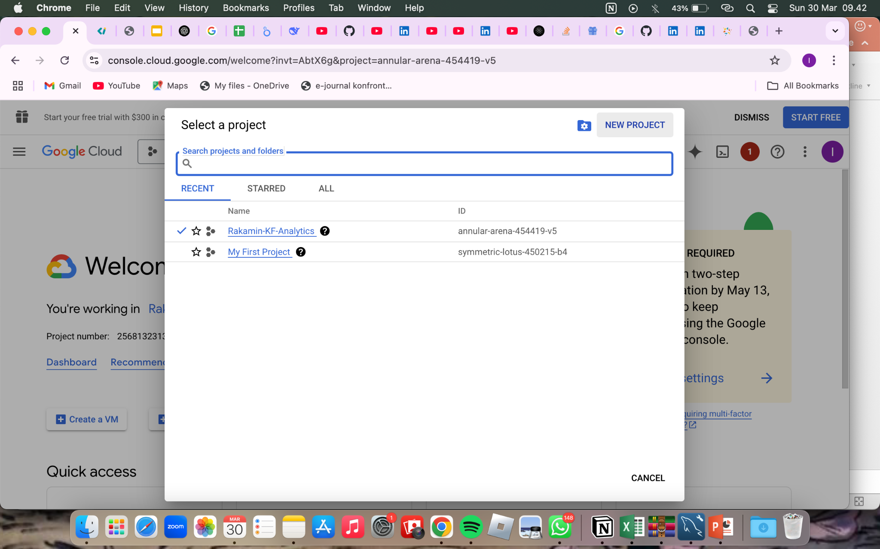
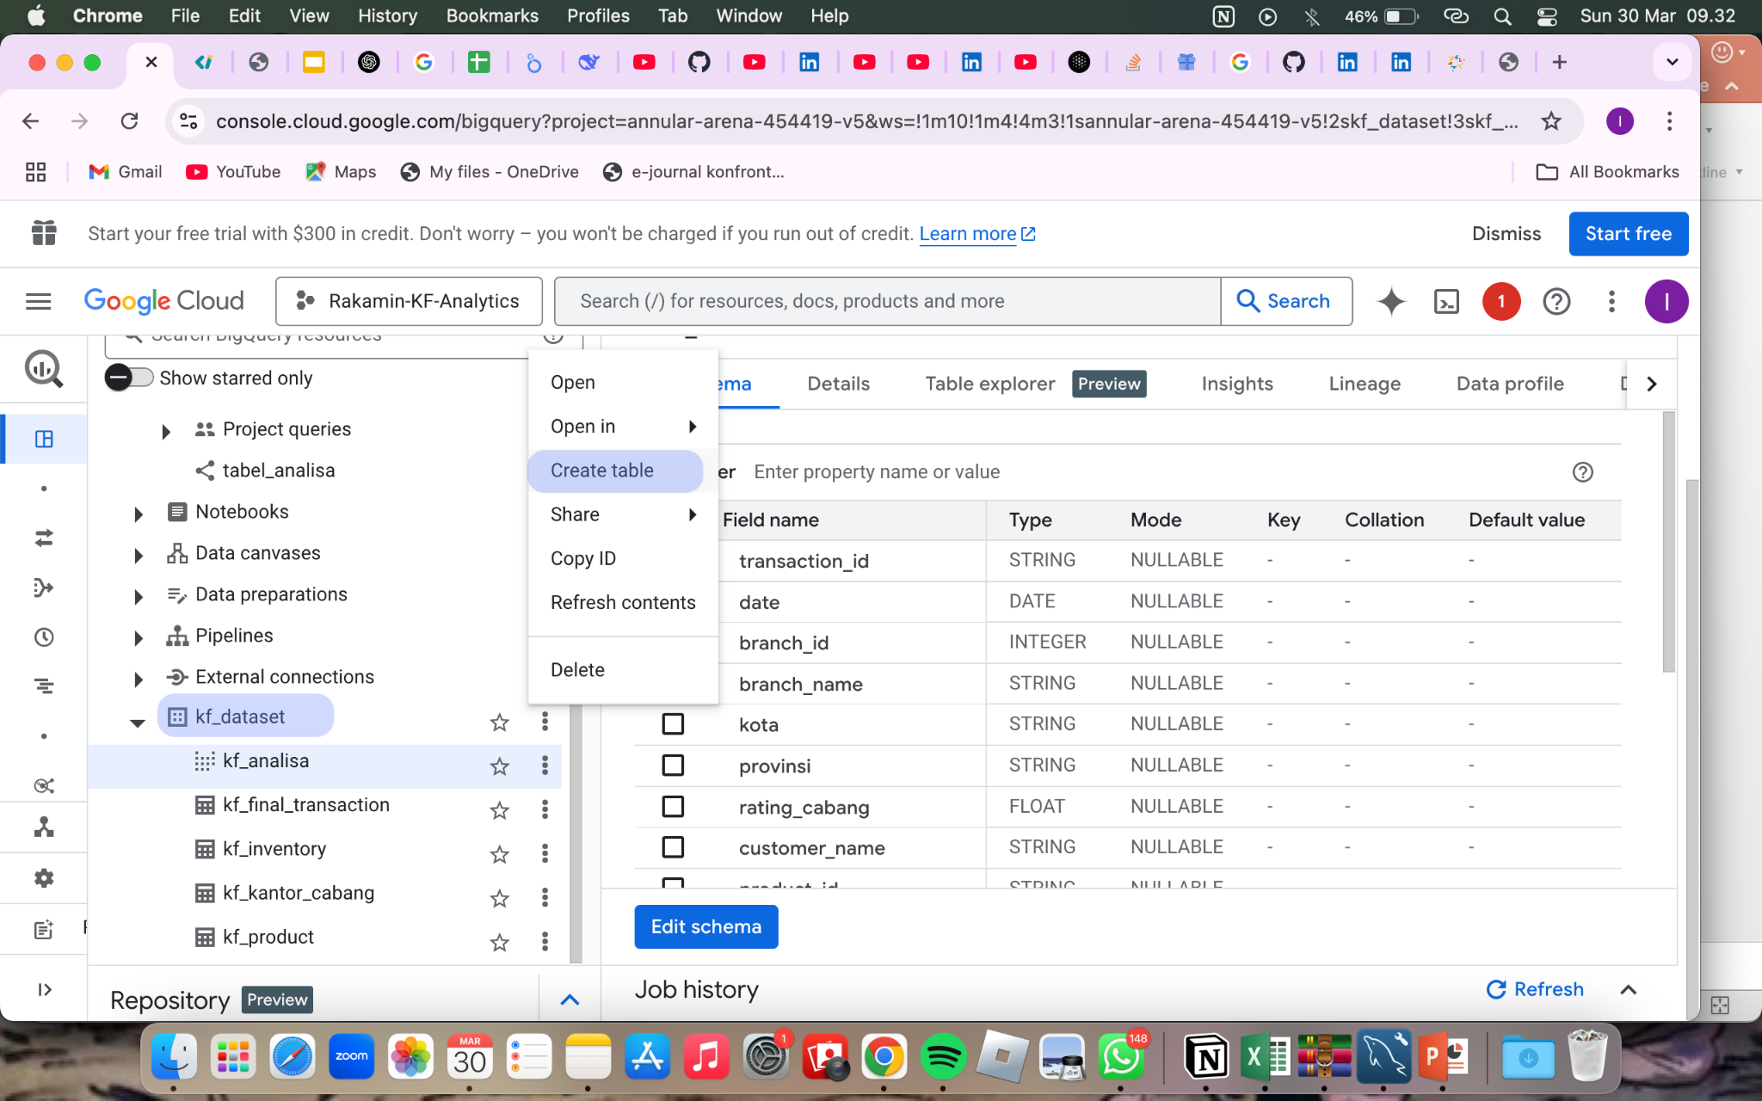
Importing Dataset to BigQuery
Step 1: Download the CSV Files
Initially, I downloaded the required CSV files to my local file.
Step 2: Access Google Cloud Console & Create a New Project
After ensuring that I had all the files ready, I logged into my Google Cloud account and navigated to the BigQuery section and create a new project “Rakamin-KF-Analytics”
Step 3: Create a New Dataset
To keep my data organized, I created a new dataset in BigQuery. I clicked on the "Create Dataset" button and name it “kimia_farma” (originally)
Step 4: Create a Table for Each CSV
For each CSV file, I needed to create a new table. I selected the dataset I just created and then clicked on the "Create Table" option.

Slide 6
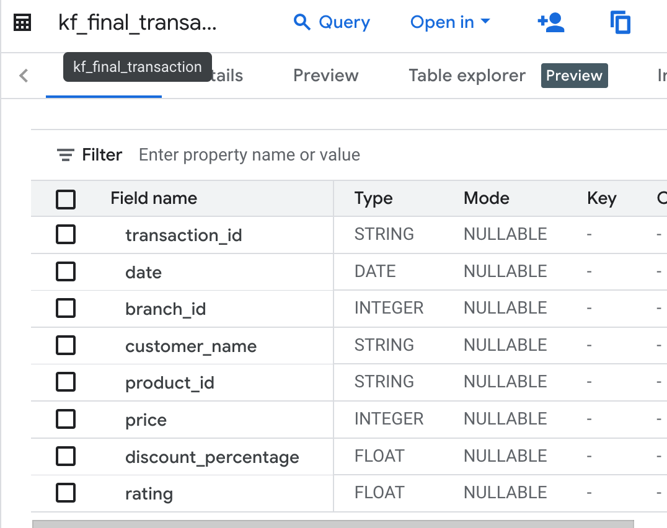
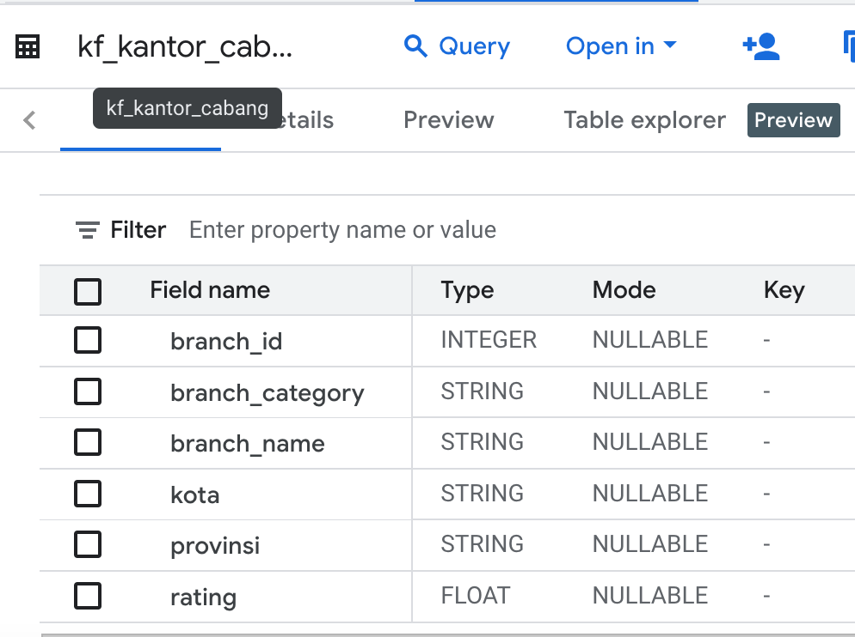
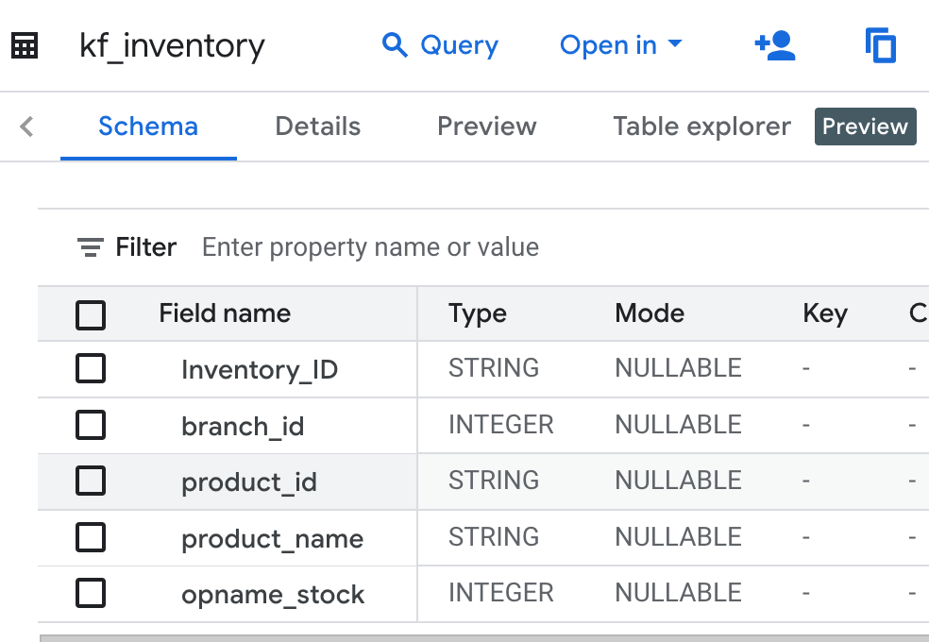
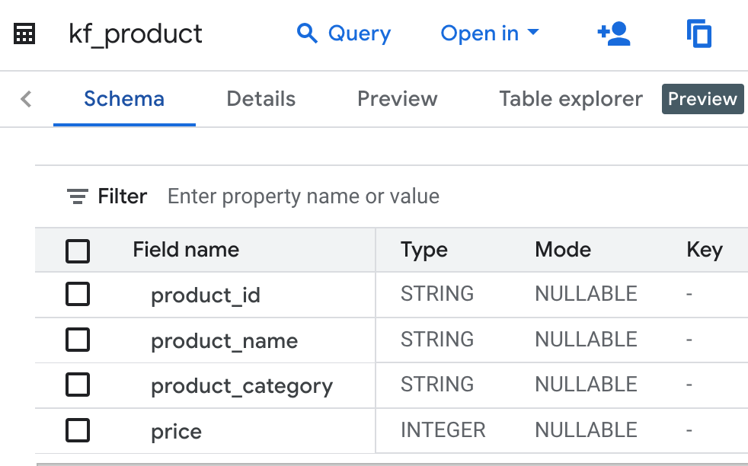
Importing Dataset to BigQuery
Step 5: Choose the Data Source
Clicked on "Browse" to locate and select the first CSV file from my local file. I repeated it for each of the remaining CSV files.
Step 10: Verify the Data
Finally, after creating all the tables, I checked each one to ensure that the data did not have missing value

Slide 7
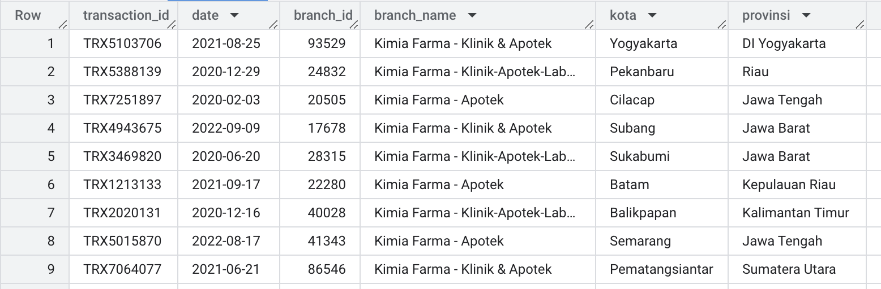
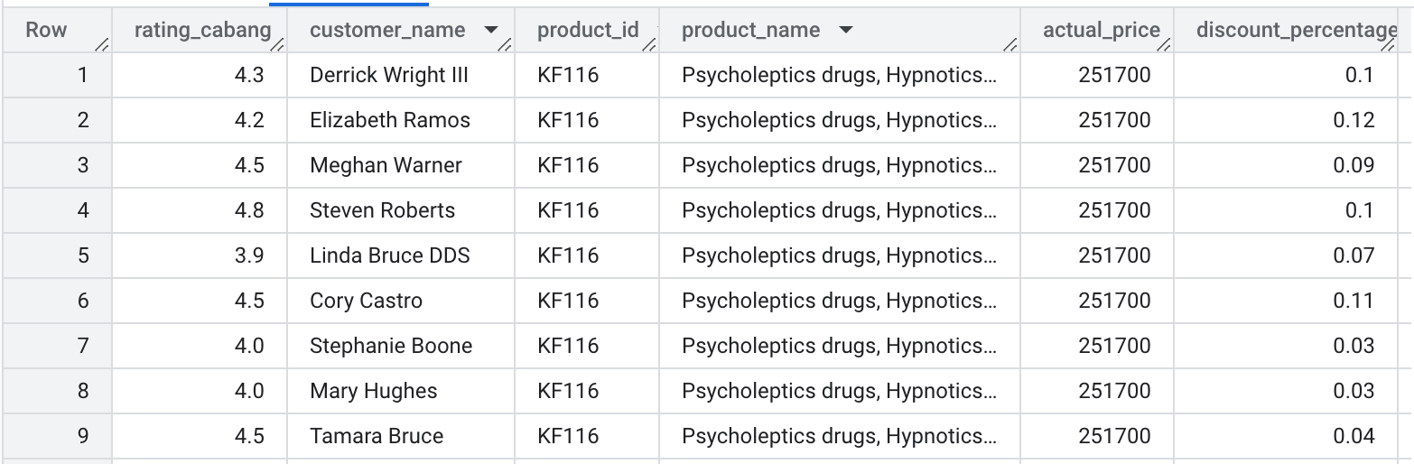
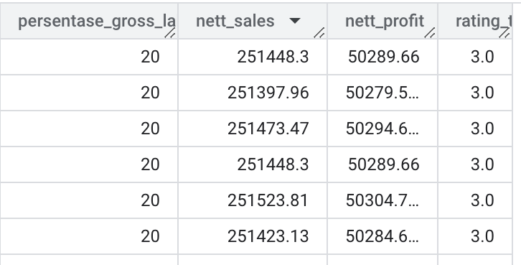
Tabel Analisa
The analysis table is based on the aggregation results from the four previously imported tables
Preview Table:

Slide 8
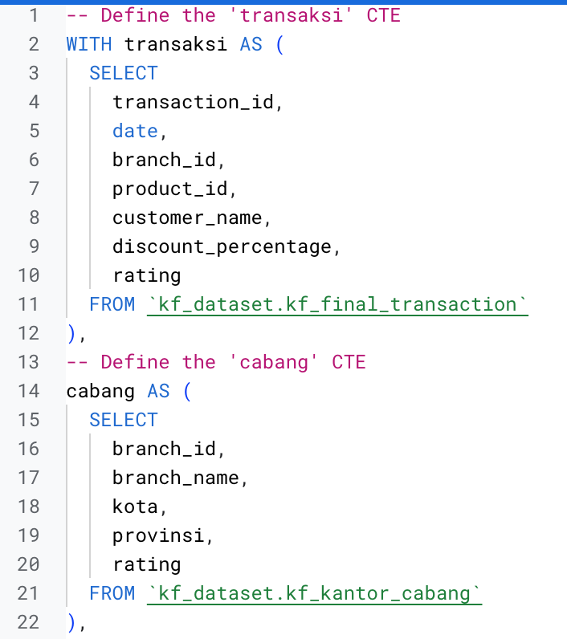
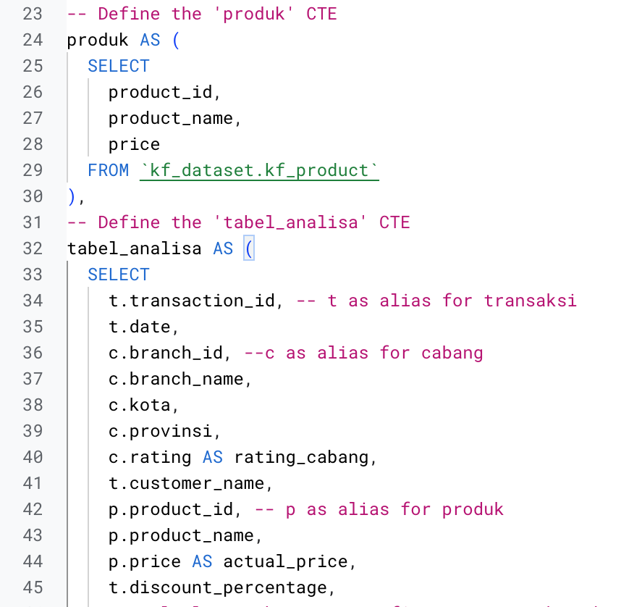
BigQuery Syntax

Slide 9
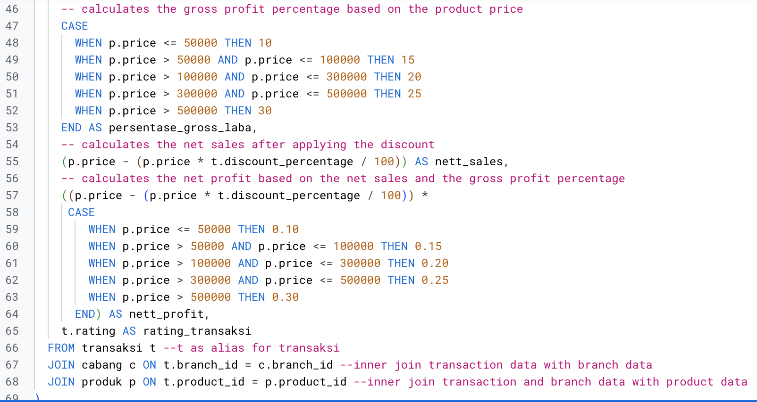
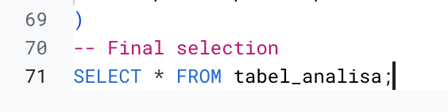
BigQuery Syntax
Notes Ketentuan persentase_gross_laba:
Harga <= Rp 50.000 -> laba 10%
Harga > Rp 50.000 - 100.000 -> laba 15%
Harga > Rp 100.000 - 300.000 -> laba 20%
Harga > Rp 300.000 - 500.000 -> laba 25%
Harga > Rp 500.000 -> laba 30%

Slide 10
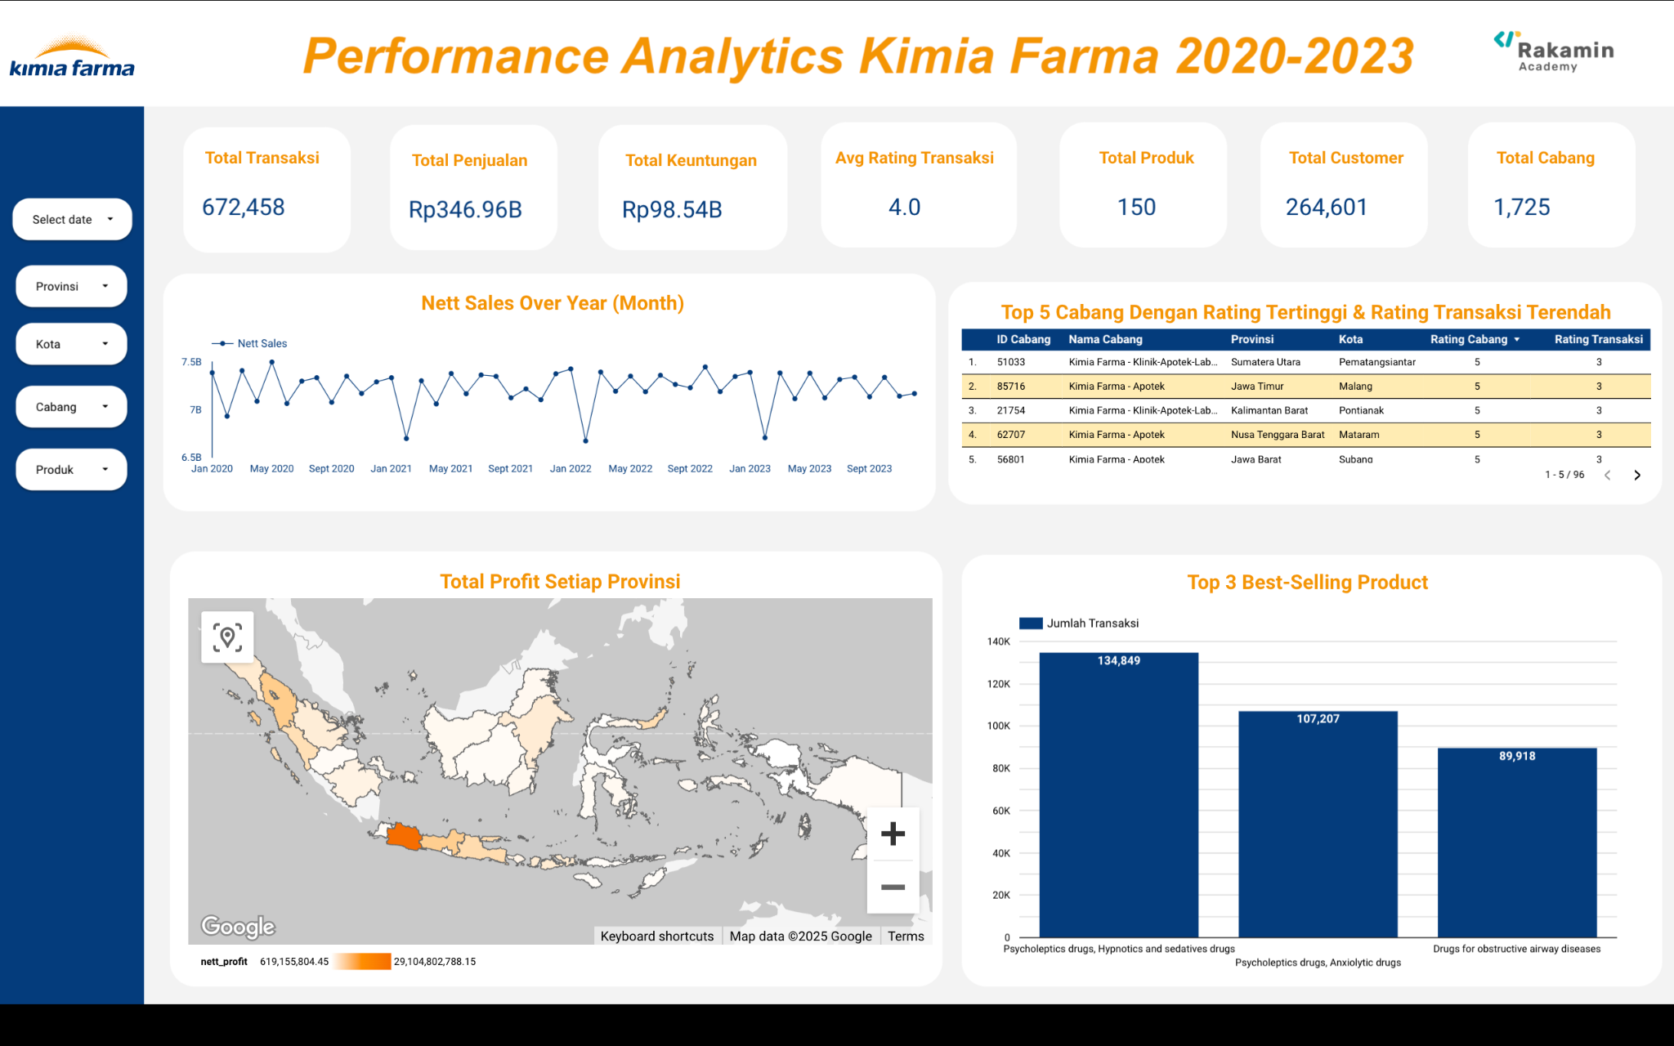
Dashboard Performance Analytics
Dashboard Link

Slide 11
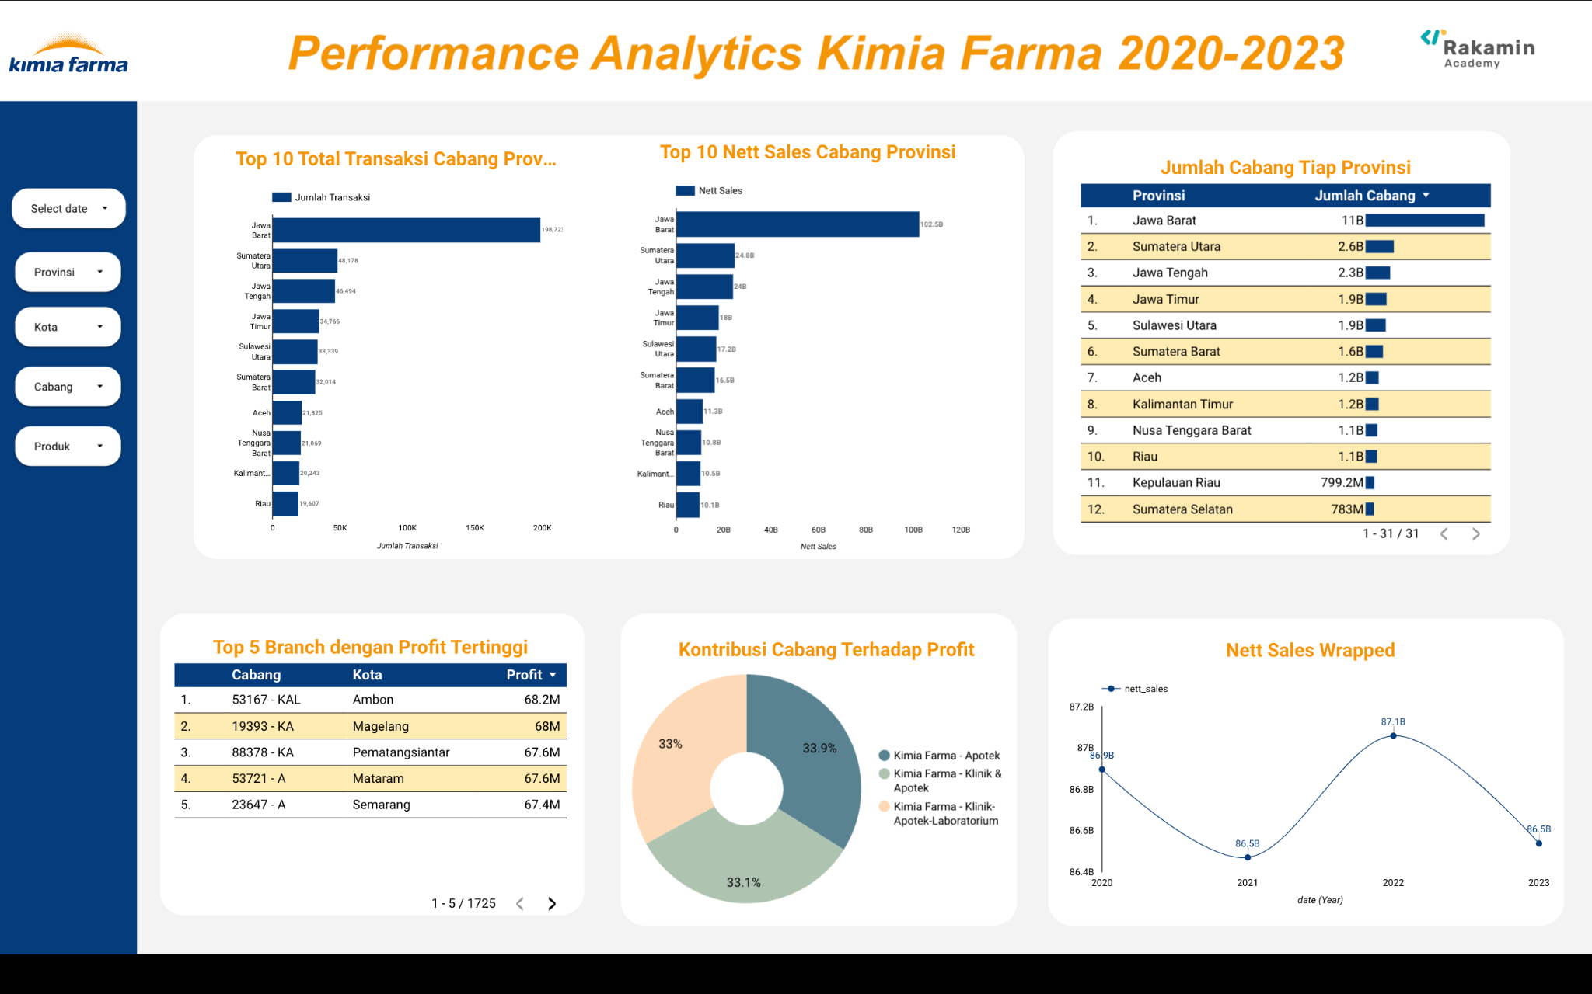
Dashboard Performance Analytics
Dashboard Link

Slide 12
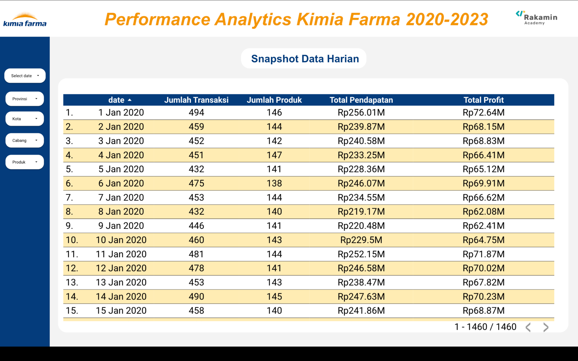
Dashboard Performance Analytics
Dashboard Link

Slide 13
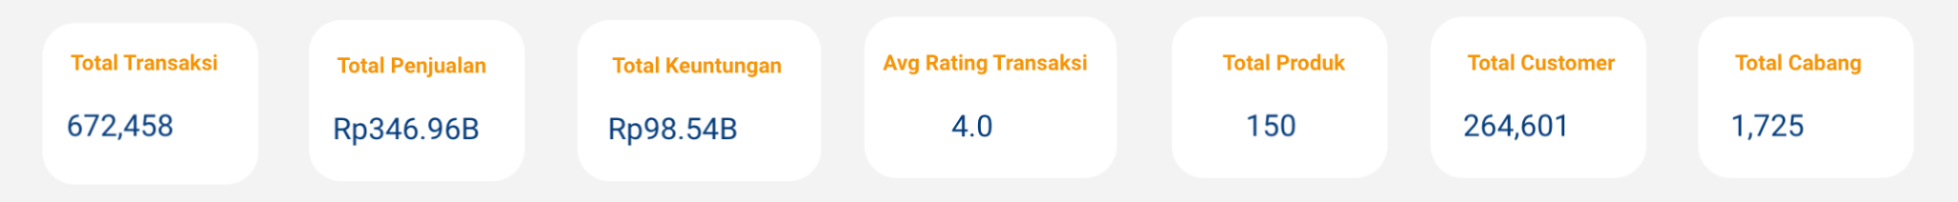
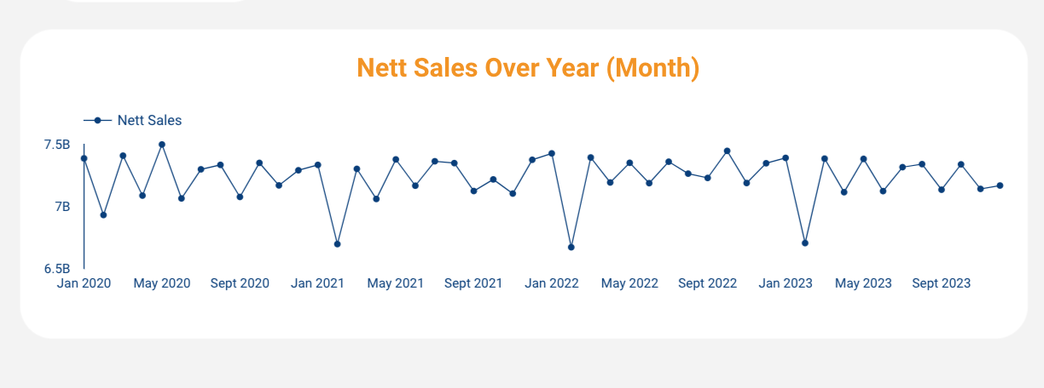
Dashboard Performance Analytics
We got 264,601 number of Customers with 672,458 number of Transactions. This indicates repeat purchase
Dashboard Summary
Trend Analysis
Showing relatively stable pattern with periodic dips and recovery
There are noticeable sharp declines around February in each year. This suggests a potential seasonal effect

Slide 14
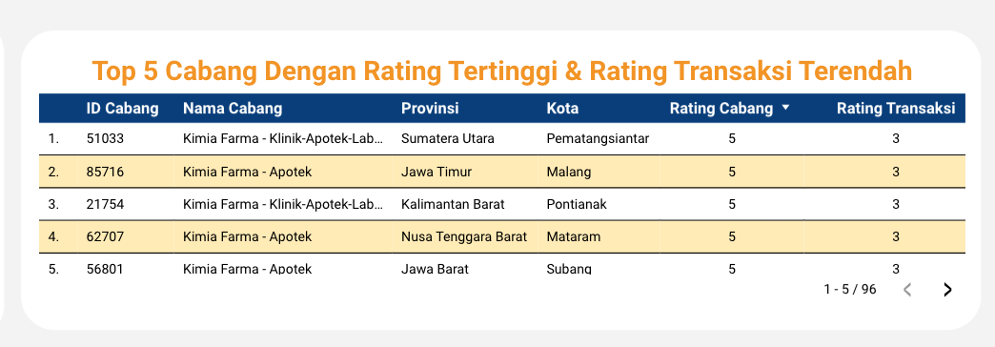
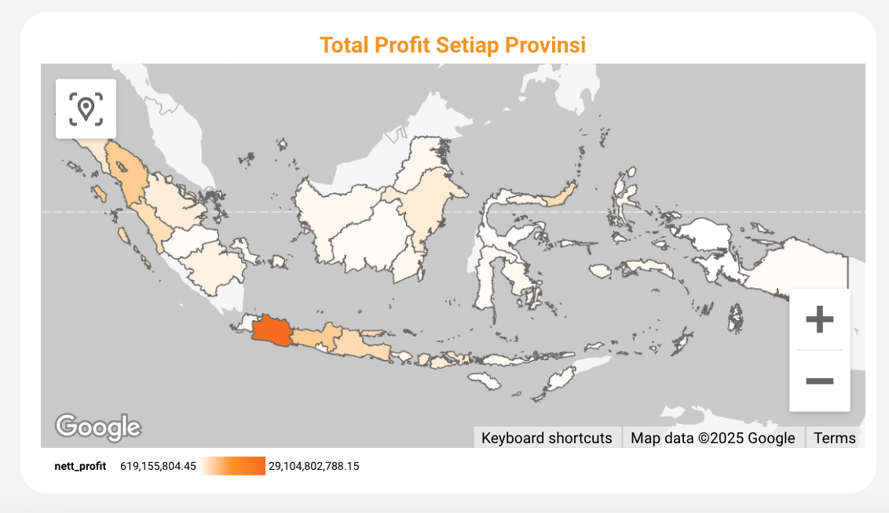
Dashboard Performance Analytics
Highly rated branch (rating = 5), meaning they are satisfied with the overall service, staff, or facilities.
But the low transaction rating suggests dissatisfaction with aspects related to the buying process, such as pricing, product availability, waiting time, or payment methods.
Provinces with higher net profit are highlighted in darker colors
High-profit provinces indicate strong market demand, high customer loyalty, or high number of branch
Jawa Barat stands out as the region with the highest number of profit while Sumatera, Kalimantan, and Sulawesi follow with relatively lower number of profit

Slide 15
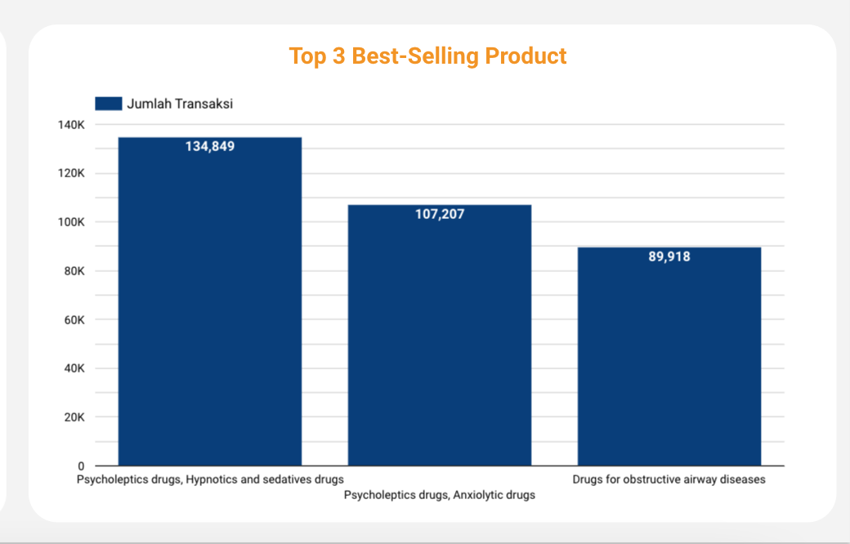
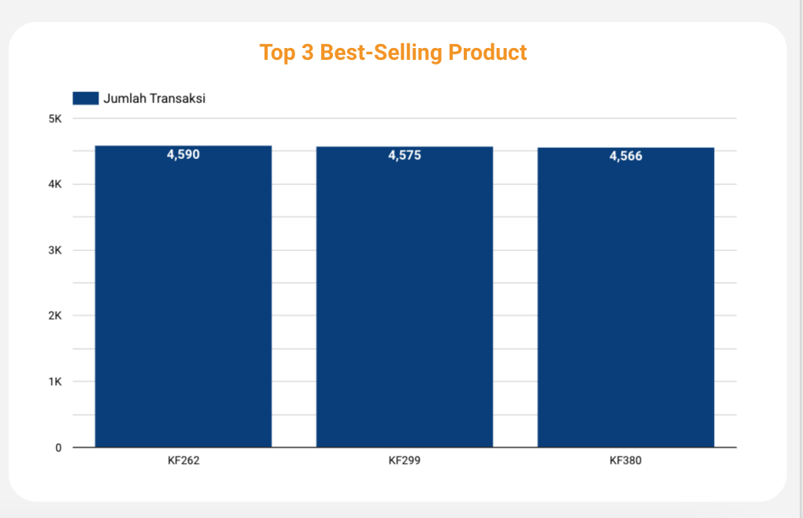
Dashboard Performance Analytics
Optimize stock levels to meet the consistently high demand. By closely monitoring sales trends, businesses can prevent stockouts.
Additionally, expanding product offerings can further capitalize on market demand by introducing complementary products
Drill down
Example:
These are the Product ID from the Top 3 Best-Selling Product Category: Psycholeptics drugs, Hypnotics, and sedatives drugs

Slide 16
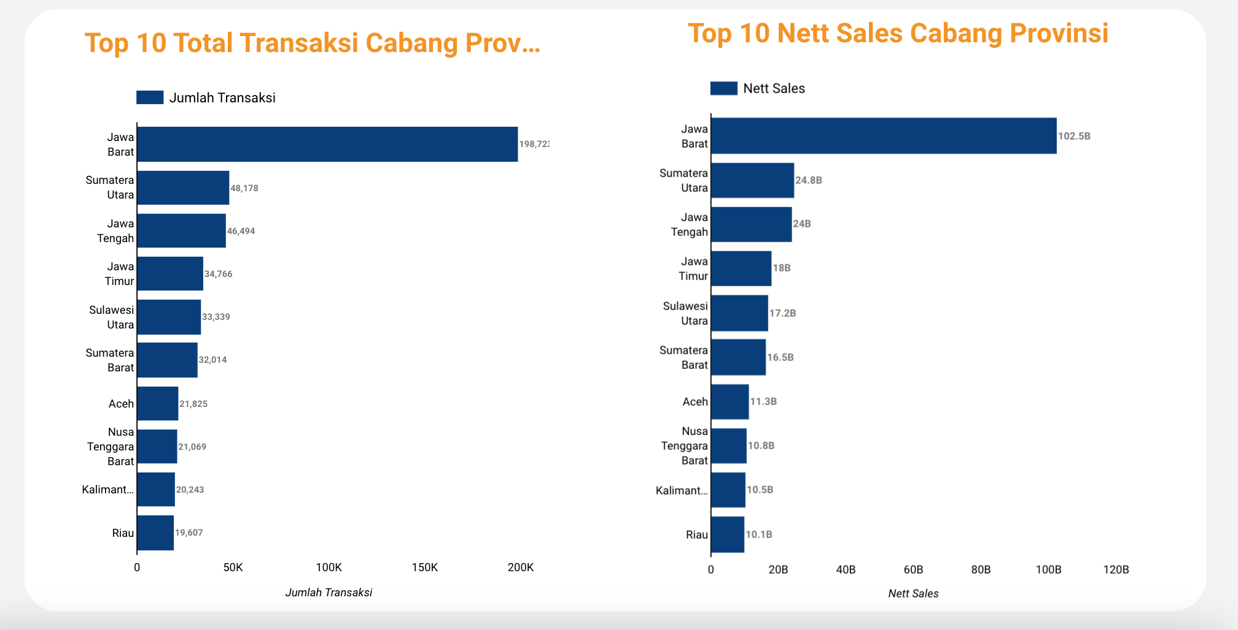
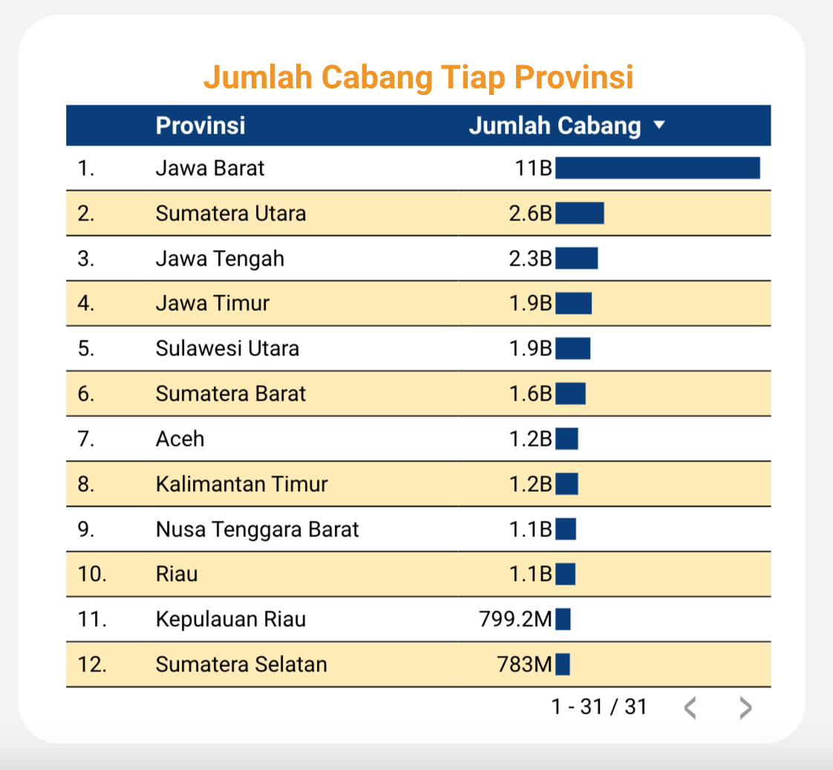
Dashboard Performance Analytics
The Top 10 Provinces with the highest number of Transactions and Nett Sales are align with the Top Provinces in number of Branch, suggesting a strong correlation between branch presence and financial performance.

Slide 17
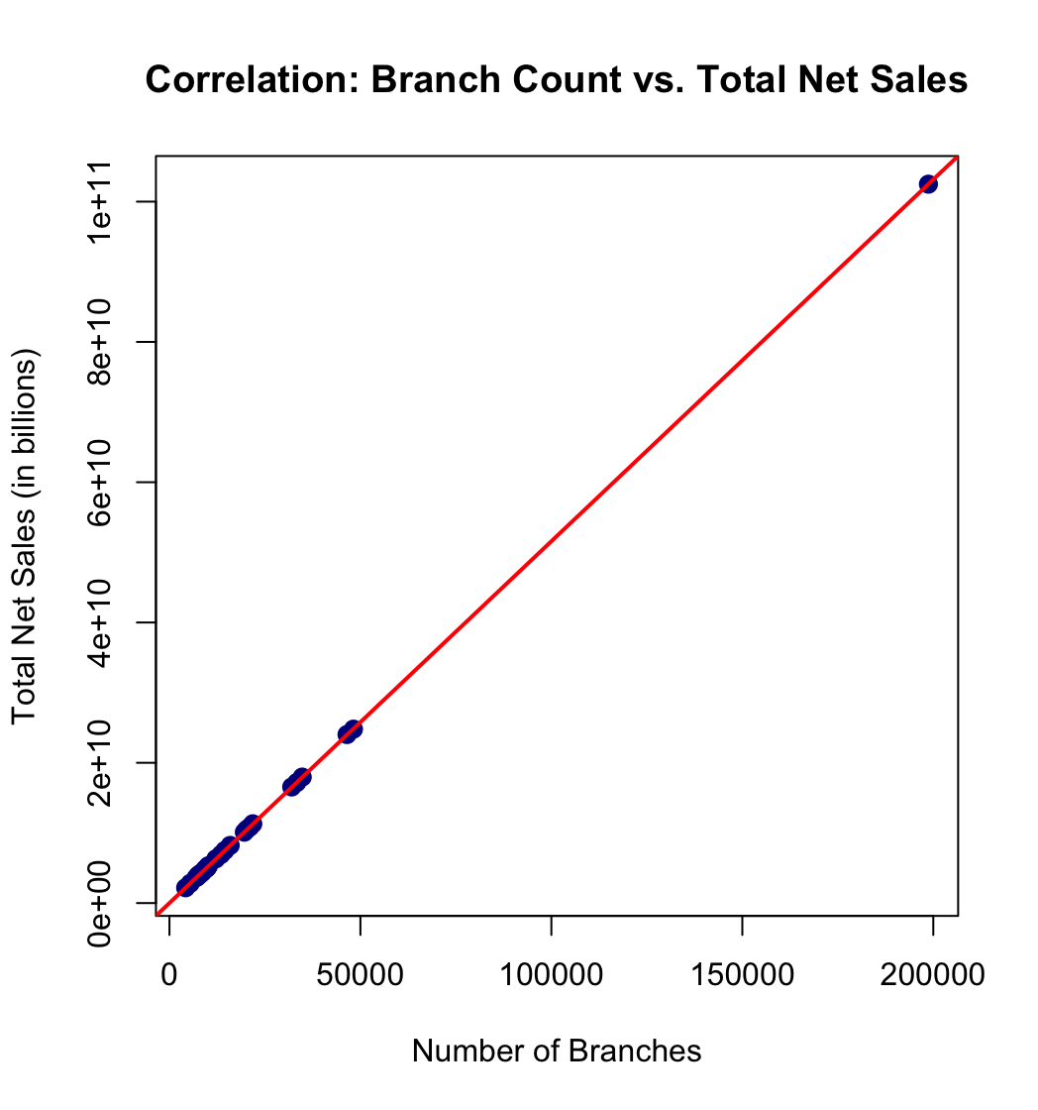
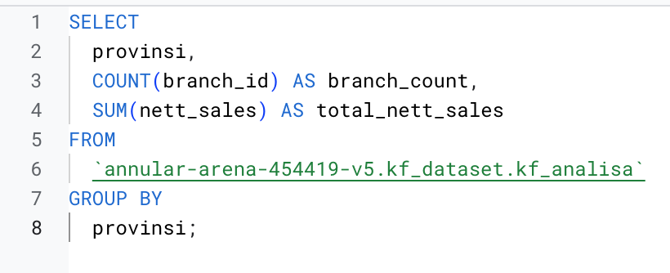
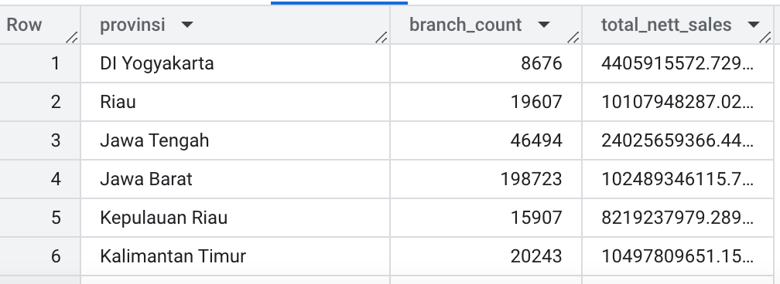
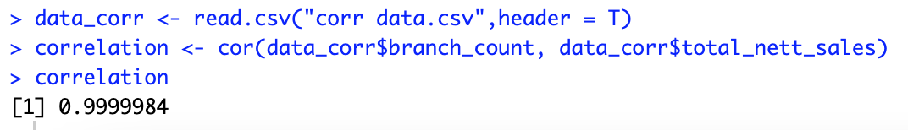
Exploration
Using Software R
The data points align almost perfectly along the red regression line, with the correlation value 0.999984 confirming an strong positive linear relationship between the number of Branches and Nett Sales

Slide 18
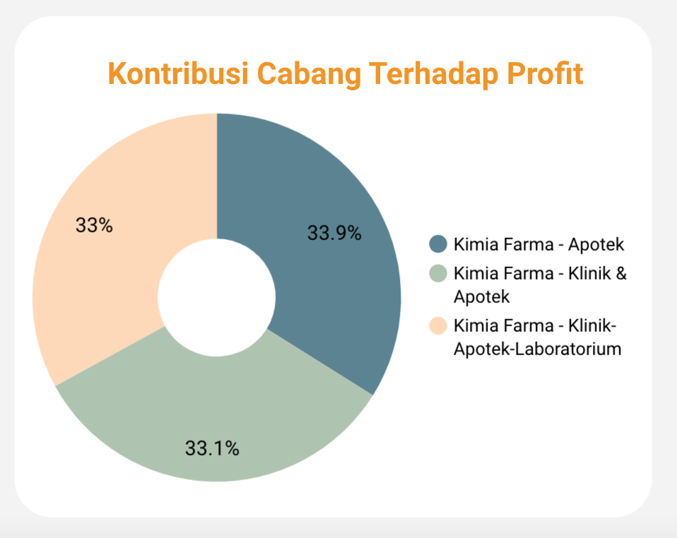
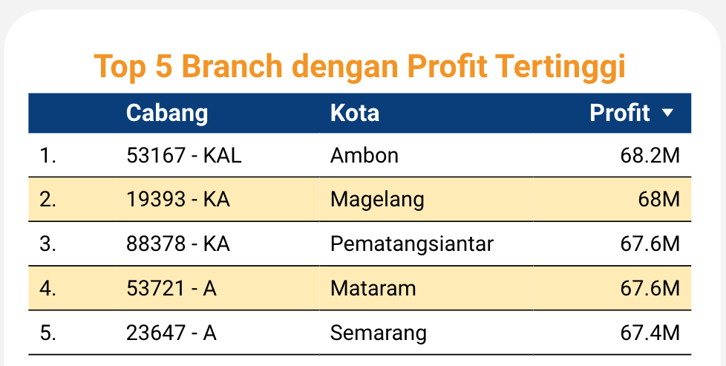
Dashboard Performance Analytics
The three types of branches (Apotek, Klinik & Apotek, and Klinik-Apotek-Laboratorium) contribute almost equally to the total profit, with percentages around 33% each.
This suggests a balanced performance across different branch models
We’re adding the more specific chart with Branch ID and Branch Name in the Top 5 with highest Profit
The top-performing branches are located in Ambon, Magelang, Pematangsiantar, Mataram, and Semarang,
Analyze the operational strategies, customer engagement, and local market conditions of the top branches and implement the successful approaches in branches with lower performance.

Slide 19
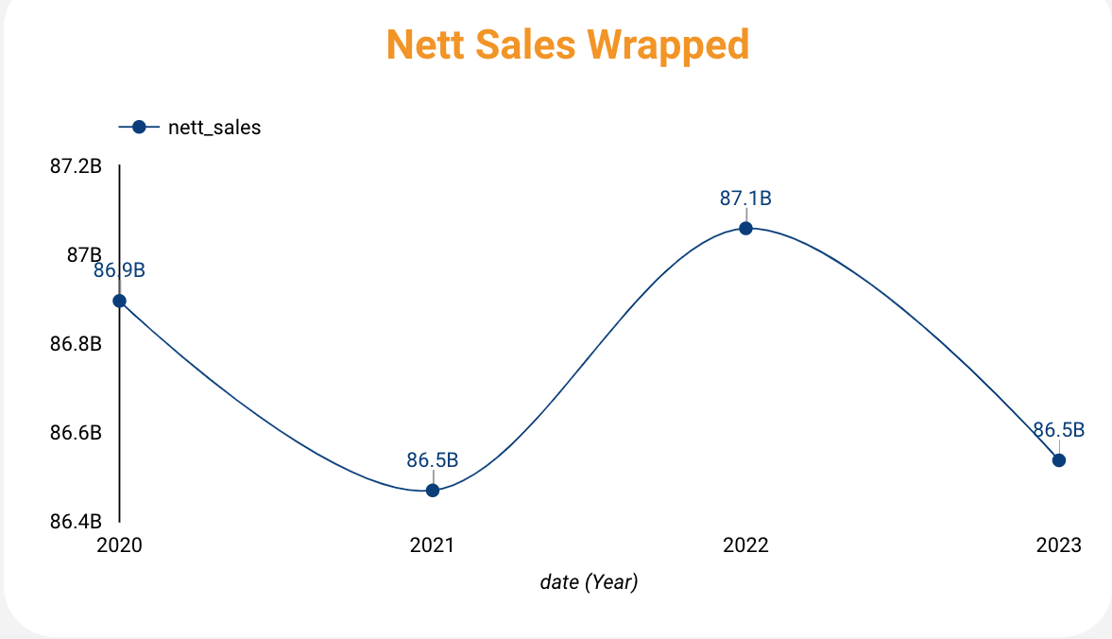
Dashboard Performance Analytics
The data shows fluctuations in the measured value over four years. The ups and downs indicate a lack of consistent growth
The decline in 2021 and 2023 suggests possible economic or external factors affecting stability, while the increase in 2022 may indicate a temporary recovery. Further analysis is needed to determine the underlying causes of these variations.
Recommendation
The increase in 2022 suggests potential opportunities. Identifying what drove this growth (e.g., increased investment, policy changes) and strengthening these factors can sustain upward trends
Implement data-driven decision-making by closely monitoring trends and using forecasting models to anticipate downturns and take proactive measures.

Slide 20
Thank You
X

